Slide 1

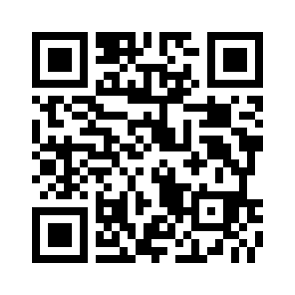
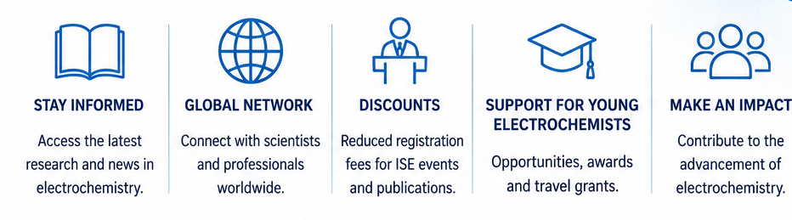

Join the International Society of Electrochemistry
Connect • Learn • Collaborate • Advance your career
Scan to join ISE
https://www.ise-online.org/membership
ISE DIVISIONS
1.Analytical Electrochemistry
Electroanalysis, sensors, spectroscopy, separation methods, analytical instrumentation.
2.Bioelectrochemistry
Biological electron transfer, biosensors, biointerfaces, bioelectrocatalysis, medical applications.
3.Electrochemical Energy Conversion and Storage
Batteries, supercapacitors, fuel cells, electrolysis, hydrogen, CO₂ conversion, energy storage.
4.Electrochemical Materials Science
Corrosion, coatings, electrodeposition, functional materials, surface engineering, materials characterization.
5.Electrochemical Process Engineering and Technology
Industrial electrochemistry, electrochemical reactors, scale-up, electrochemical manufacturing, process engineering.
6.Molecular Electrochemistry
Organic, inorganic and organometallic electrochemistry, electrosynthesis, molecular mechanisms.
7.Physical Electrochemistry
Fundamental electrochemistry, electrode kinetics, interfacial phenomena, theory, modeling and simulation, photoelectrochemistry.
Become a Member Today!
Young Members: €25
(30 years or younger)
Senior Members: €65
(over 30 years)

